Slide 1

“BARBARIKA” ADVANCED TECHNOLOGY FOR SURVEILLANCE AND SECURITY
Batch 49
Name USN
DEEPAK. Y 1NT18EC050
YATHISH .TL 1NT18EC189
SUMANTH. A METIMATH 1NT18EC196
TEJAS PRASAD RAO 1NT19EC417
Project Supervisor
Prof. Dr.Ramachandra.AC
Head of the Department

Slide 2
Presentation Outline
Introduction.
Objectives.
Literature Survey.
Basic Architecture.
Methodology.
Algorithms used.
Comparison between ML algorithms.
Evaluation and analyzation of algorithms.
Experimental Results.
Conclusions & Future scope.

Slide 3
Objectives:-
OBJECTIVES
To understand the importance of biometrics in the field of law enforcement agency.
To acquire the knowledge of dataset.
To analyze identification process by using LBPH, LDA and PCA algorithms.
To develop an environment using the python and its libraries.
To create a database system of size (92x112 px for AT&T Database, 13233 images of Labelled faces of the wild Database, 10,524 images of Caltech face Database) to work with the environment.
Creation of GUI interface with the user.
Testing of data and dynamic usage of the database created.

Slide 4
LITERATURE SURVEY
Literature Survey
Authors Name | Citation | Technique used | Conclusion
Anil K. Jain Brendan Klare | A. K. Jain and B. Klare, "Matching Forensic Sketches and Mug Shots to Apprehend Criminals," in Computer, vol. 44, no. 5, pp. 94-96, May 2011, doi: 10.1109/MC.2011.153. | scale-invariant feature transform (SIFT) and multiscale localbinary pattern (MLBP) local-feature-based discriminant analysis (LFDA) | It showed four times improvement in accuracy over a commercial off-the-shelf (COTS) face recognition system
Mishra, Pawan & Nautiyal, Jyoti & Gahlot, Shivali | Mishra, Pawan & Nautiyal, Jyoti & Gahlot, Shivali. (2013). An Automated Technique for Criminal Face Identification Using Biometric Approach. Conference on Advances in Communication and Control Systems. 608-611. | Image partition algorithm | Input image is scanned at almost every pixel location and scale, to boost the performance of the detector along with the enhanced accuracy
Dar, Showkat & Palanivel, S. | Dar, Showkat & Palanivel, S. (2021). Neural Networks (CNNs) and Vgg on Real Time Face Recognition System. 1809-1822. | CNN (Convolutional Neural Network) along with VGG-16 | The proposed system can successfully recognize 24 different person faces which are which could be useful in searching suspects

Slide 5
Authors Name | Citation | Technique used | Conclusion
S. J. Klum, H. Han, B. F. Klare and A. K. Jain | S. J. Klum, H. Han, B. F. Klare and A. K. Jain, "The FaceSketchID System: Matching Facial Composites to Mugshots," in IEEE Transactions on Information Forensics and Security, vol. 9, no. 12, pp. 2248-2263, Dec. 2014, doi: 10.1109/TIFS.2014.2360825. | Holistic Algorithm | The FaceSketchID System combines the strengths of two different representation and matching algorithms (holistic and component-based) to achieve state-of-the-art accuracies for both (hand-drawn composite, mugshot) and (software-generated composite, mugshot) pairs
Muhammad Awais; Muhammad Javed Iqbal; Iftikhar Ahmad | M. Awais et al., "Real-Time Surveillance Through Face Recognition Using HOG and Feedforward Neural Networks," in IEEE Access, vol. 7, pp. 121236-121244, 2019, doi: 10.1109/ACCESS.2019.2937810. | HOG and Feedforward Neural Networks | The work presented in this paper provides video surveillance with improved accuracy and less computational complexity. The most significant part of the system consists of face localization, detection and recognition. The system obtains underlined facial data through a video dataset or from the real-time environment
C. T. Yew and S. A. Suandi | C. T. Yew and S. A. Suandi, "A study on face recognition in video surveillance system using multi-class Support Vector Machines," TENCON 2011 - 2011 IEEE Region 10 Conference, 2011, pp. 25-29, doi: 10.1109/TENCON.2011.6129056. | multi-class Support Vector Machines | In this study, we performed a few experiments to evaluate the performance of linear kernel multi-class SVM for face recognition task in surveillance system. The highest overall recognition rate is 80.76% when images from Camera 2 are trained and tested with images from Camera 1, 3 and 4
Ayyappan, S. & Matilda | Ayyappan, S. & Matilda, S.. (2020). Criminals And Missing Children Identification Using Face Recognition And Web Scrapping. 1-5. 10.1109/ICSCAN49426.2020.9262390. | haar classifier | In this work, we compare the various types of images and the accuracy level of results is very satisfying. It performs well with both images and videos. The results displayed are 90% accurate.

Slide 6
Authors Name | Citation | Technique used | Conclusion
C. Galea and R. A. Farrugia | C. Galea and R. A. Farrugia, "Matching Software-Generated Sketches to Face Photographs With a Very Deep CNN, Morphed Faces, and Transfer Learning," in IEEE Transactions on Information Forensics and Security, vol. 13, no. 6, pp. 1421-1431, June 2018, doi: 10.1109/TIFS.2017.2788002. | Deep convolutional neural network | The proposed approach comprehensively outperforms state-of-the-art methods on all publicly available composite sketch datasets.
A. Khan, Sakhi Rehman, Muhammad Waleed | A. Khan et al., "Forensic Video Analysis: Passive Tracking System for Automated Person of Interest (POI) Localization," in IEEE Access, vol. 6, pp. 43392-43403, 2018, doi: 10.1109/ACCESS.2018.2856936. | face recognition, human identification in video streaming based on facial classification parameters and motion variation on a Region Of Interest (ROI). | The proposed system is capable of generating tracking information for POI effectively.
M. Zhang, R. Wang, X. Gao, J. Li and D. Tao | M. Zhang, R. Wang, X. Gao, J. Li and D. Tao, "Dual-Transfer Face Sketch–Photo Synthesis," in IEEE Transactions on Image Processing, vol. 28, no. 2, pp. 642-657, Feb. 2019, doi: 10.1109/TIP.2018.2869688. | Inter-domain transfer process and an intra-domain transfer process. | The proposed framework produces more identifiable facial structures and yields higher face recognition performance in both the photo and sketch domains.

Slide 7
Authors Name | Citation | Technique used | Conclusion
Lien, Yao-Nan & Chi, Li-Cheng & Shaw, Yuh-Sheng | Lien, Yao-Nan & Chi, Li-Cheng & Shaw, Yuh-Sheng. (2009). A Walkie-Talkie-Like Emergency Communication System for Catastrophic Natural Disasters. 309-314. 10.1109/I-SPAN.2009.85. | subsystem of P2Pne | This paper demonstrates the design of a Walkie-Talkie-like communication system over a MANET based P2Pnet. The system is designed to support emergency communications in the early hours or day
Lien, Yao-Nan & Chi, Li-Cheng & Huang, Chih-Chieh | Lien, Yao-Nan & Chi, Li-Cheng & Huang, Chih-Chieh. (2010). A Multi-hop Walkie-Talkie-Like Emergency Communication System for Catastrophic Natural Disasters. 527-532. 10.1109/ICPPW.2010.77. Kamthe, U. & Patil, C.. (2018). Suspicious Activity Recognition in Video Surveillance System. 1-6. 10.1109/ICCUBEA.2018.8697408. | MANET P2P network | The system is designed to support emergency communications in the early hours or daythe research on the emergency communication systems that is inexpensive and easy to deploy

Slide 8
Summary of Literature Survey
Summary of Literature Survey
There are various ways to approach the problem statement.
Most used techniques are deep learning , Neural networks , Haar classifier.
Techniques used for communication are walkie talkie
The model usage for Suspicious Activity are very less and the model complexity increases.
Understanding about how to communicate nearby policemen , when criminal and Suspicious Activity are identified.

Slide 9
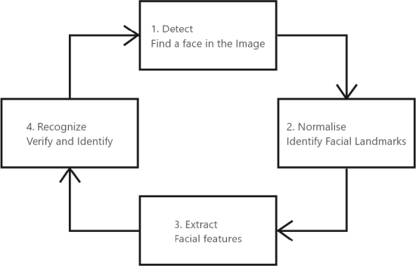
Basic Architecture
Fig1: Basic block diagram of face detection and recognition system.

Slide 10
Flowchart of our code
Dataset Creation
Training of Algorithm
Recognition
Fig2: Flowchart of our code.

Slide 11
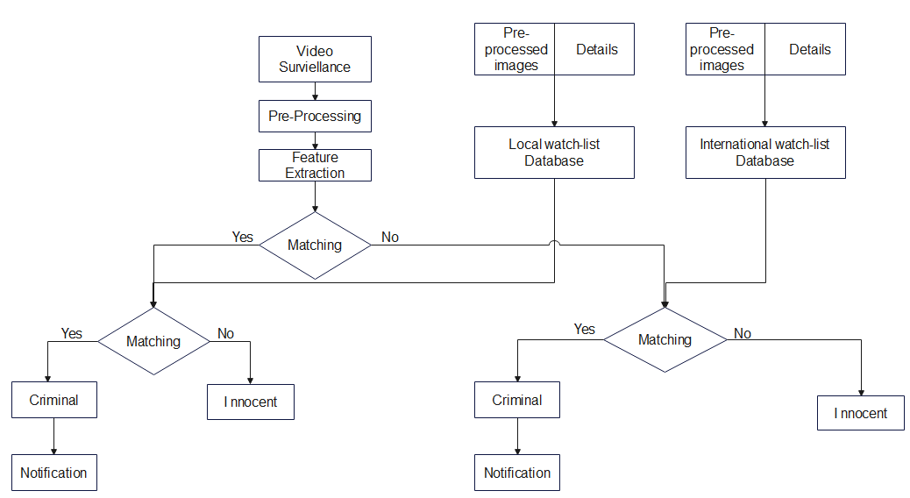
Methodology of the Project
Fig3: Working flowchart of our project.

Slide 12
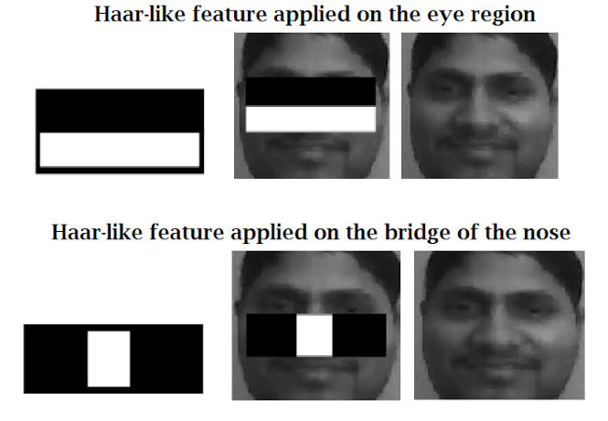
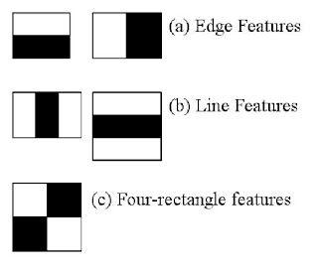
Dataset Description (Haar Cascade)
Dataset Description (Haar Cascade)
The dataset are collected from the internet by Open CV and our faces have been added to the dataset by Haar cascade algorithm
Haar cascade is an object detection algorithm used to identify faces in an image or real time video

Slide 13
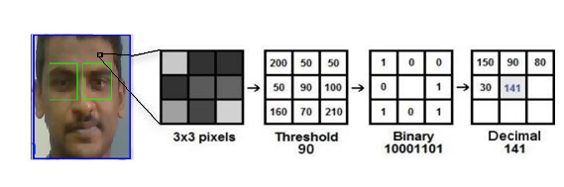
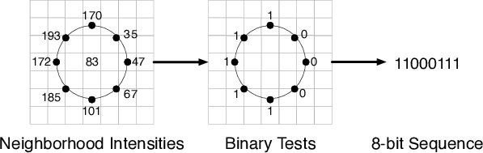
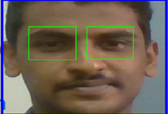
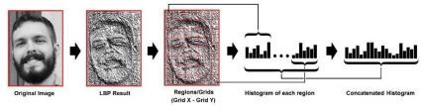
Local Binary Pattern Histogram
Local Binary Pattern Histogram
LBPH is a Face Recognition Algorithm used to recognize the face of a Person.
It makes use of a data-set of images of the people to be included in the recognition process. Each image is given a unique ID as either a number or the name of a person so that the algorithm can use this information to identify the image and export the output.

Slide 14
Libraries and Algorithms
Open CV.
Numpy.
PIL.
Haar cascade.
LBPHF recognizer.

Slide 15
Comparison between ML Algorithms
We’ve used Three Algorithms to Test and Analyse the facial recognition model.
Fisher Faces Algorithm.
→PCA Algorithm.
→LDA Algorithm.
LBPH Algorithm.

Slide 16
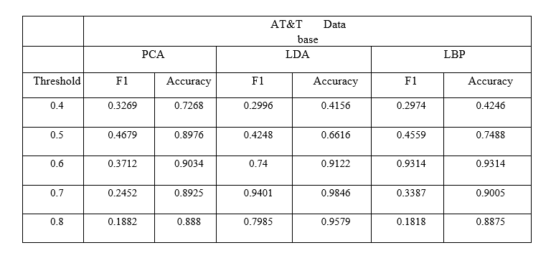
F1 Score vs Accuracy of AT&T Database:
Evaluation and analyzation of algorithms

Slide 17
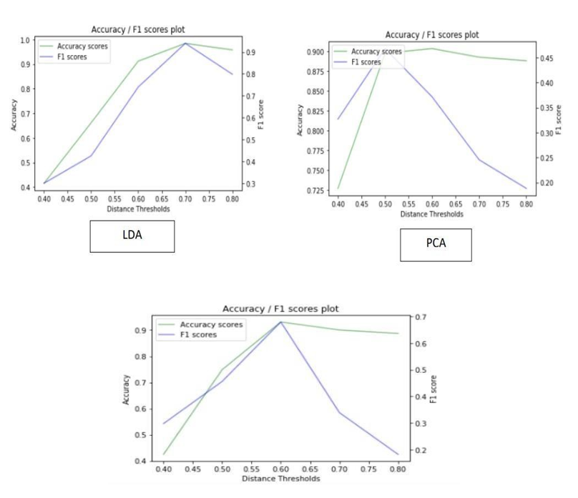
F1 Score vs Accuracy of AT&T Database:

Slide 18
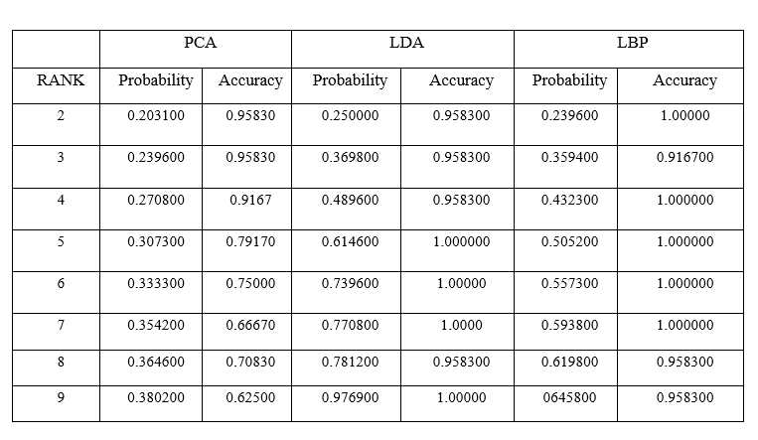
Probability vs Accuracy of AT&T Database:

Slide 19
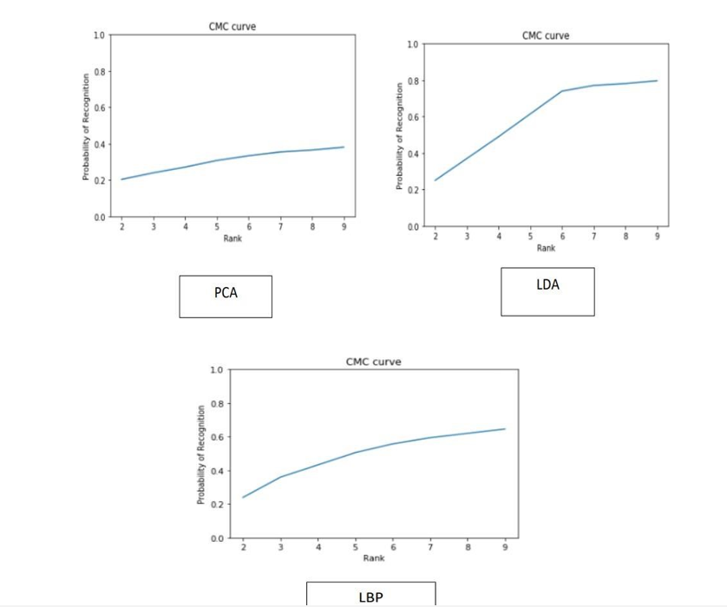
Probability vs Accuracy of AT&T Database:

Slide 20
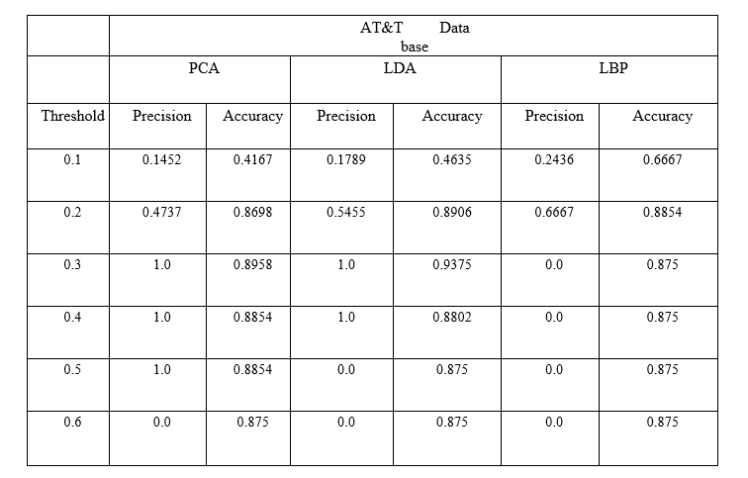
Precision vs Accuracy of AT&T Database:

Slide 21
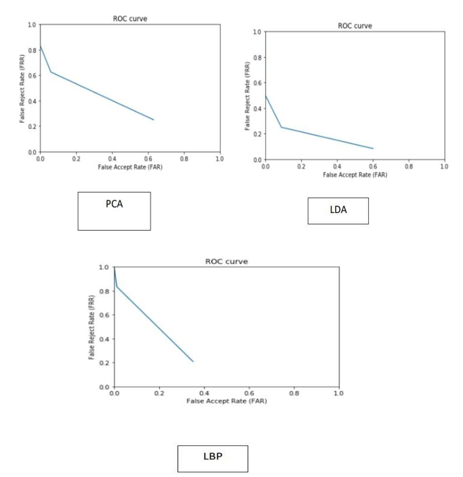
Precision vs Accuracy of AT&T Database:

Slide 22
Experimental Results
In our project,
The law enforcement agent would be able log-in or register himself before he can access the GUI, add and manipulate criminal data using the GUI and store it within the database, analyze real-time surveillance video to detect suspects from an array of live video feeds.

Slide 23
Conclusions
LBPH is one of the easiest face recognition algorithms that can be fine tuned to our requirements.
Challenging part for face recognition using Eigen face is the changes in the details like, background, posture, facial expression, scaling etc.
Face recognition system using fisher face methods: facial image was found to be correctly recognized 100% of our testing period and facial recognition was found to be 93% accurate in our testing period.
We’ve understood that mostly, images that fail in recognition are by two factors, namely scaling factors and poses.

Slide 24
Future Scope
The application be implemented in real time and the database of criminals and citizen can be maintained and the high vision cameras can be used for accurate identification of the criminal in the public place and also add new features like suspicious activity prediction and give additional security and maintain peace and laws in the society.

Slide 25
Thank You

